Slide 1
Fast pressure distribution prediction of airfoils using deep learning
Presentation : Hyejin Kim
Xinyu Hui¹, Junqiang Bai¹, Hui Wang¹, and Yang Zhang^{2,3}
¹School of Aeronautics, Northwestern Polytechnical University
²State Key Laboratory for Strength and Vibration of Mechanical Structures, School of Aerospace Engineering, Xi'an Jiaotong University
³National Key Laboratory of Science and Technology on Aerodynamic Design and Research,
Aerospace Science and Technology, Vol. 105, October 2020

Slide 2
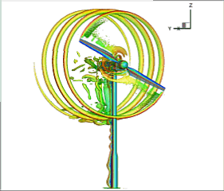
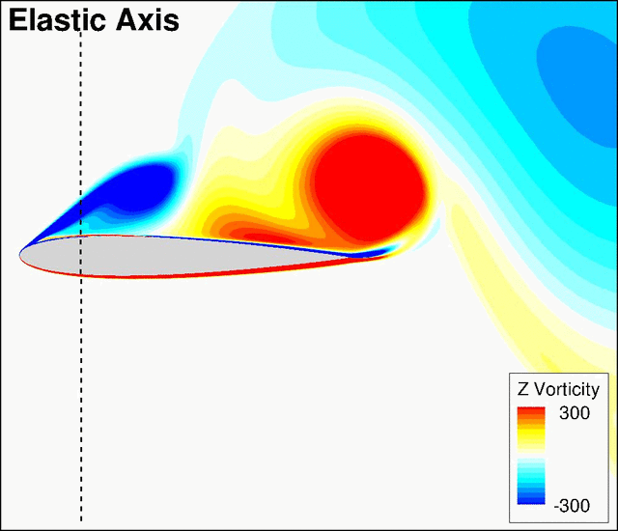
Introduction
Computational fluid dynamics (CFD)
Time consuming due to the inherent complexity of fluid dynamics
Complexity of Simulations
Navier-Stokes equations
Spatial and Temporal Resolution
To model fluid flow accurately, a high spatial and temporal resolution, especially for turbulent flows or flows with small-scale features are needed
Meshing
The quality and resolution of the mesh significantly impact simulation accuracy, and generating a suitable mesh can be a non-trivial process
Construct surrogate model by introducing deep learning

Slide 3
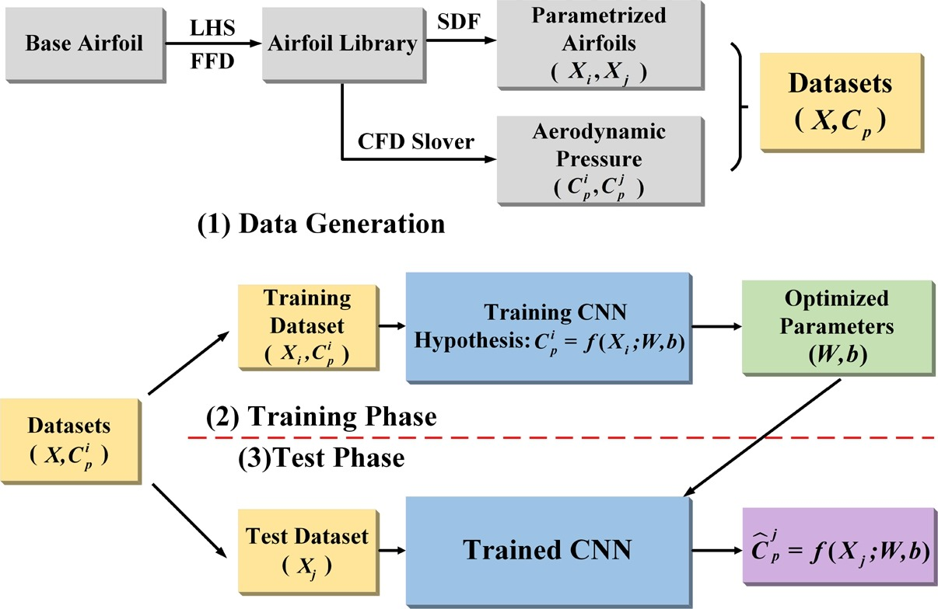
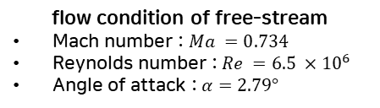
Machine learning method
Entire framework
1. Data generation
Airfoil library (Using Latin Hypercube Sampling (LHS), Free-Form Deformation (FFD))
FFD is a powerful tool in the geometric design of 2D and 3D objects
Each control points can move perpendicular in the range of [−0.02, 0.02]
flow condition of free-stream
Mach number : $Ma =0.734$
Reynolds number : $Re =6.5 ×{10}^{6}$
Angle of attack : $α=2.79°$
Airfoil geometry
Validation CFD solver
1,500 airfoils are generated
RAE2822
Upper surface
Mesh
Lower surface
Sampling by LHS
Control points
Dataset airfoil library
Pressure coefficient (Cp)

Slide 4
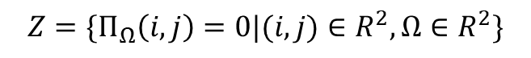
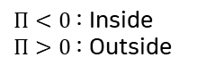
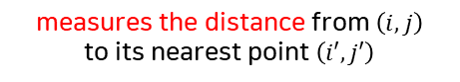
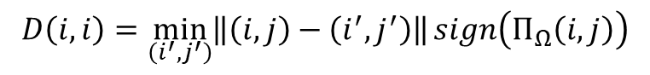

Machine learning method
Entire framework
1. Data generation
Representation of airfoil geometry by SDF
The airfoils are converted 32by32 cartesian grid by using Signed distance function (SDF)
Signed distance function (SDF)
Airfoil geometry
Like 2D image!
1,500 airfoils are generated
Airfoil boundary :
$Π<0$ : Inside
$Π>0$ : Outside
Upper surface
Airfoil
Lower surface
$$Z=\{Π_{Ω}\left(i,j\right)=0|(i,j)∈R^{2},Ω∈R^{2}\}$$
Sampling by LHS
Signed distance function $D(i,j)$ :
$$D\left(i,i\right)=\min_{\left(i^{′},j^{′}\right)}\left\|\left(i,j\right)−\left(i^{′},j^{′}\right)\right\|sign\left(Π_{Ω}\left(i,j\right)\right)$$
measures the distance from $\left(i, j\right)$ to its nearest point $\left(i′, j′\right)$
Control points
Dataset airfoil library
determines whether the point is in-side or outside the airfoil
SDF of base airfoil RAE2822 in a 32 ×32Cartesian grid
Notes:
Here, the points outside the airfoil have positive values, and de-crease as the points approaching to the boundary of the geometry where the values are zeroes, and they become negative once inside the airfoil.
To generate the SDF for objects, the background mesh is an evenly distributed Cartesian grid.

Slide 5
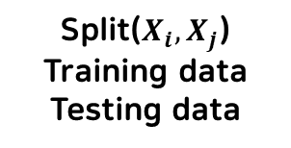
Machine learning method
Entire framework
1. Data generation
Datasets consist of 2D airfoil image and corresponding Cp
2D airfoil images for each airfoil shape
Corresponding pressure coefficient
Mesh
Like 2D image!
Airfoil
Datasets
(X, Cp)
Split($X_{i}, X_{j}$)
Training data
Testing data
The SDF representation of base airfoil RAE2822 in a 32 ×32Cartesian grid
Pressure coefficient (Cp)

Slide 6
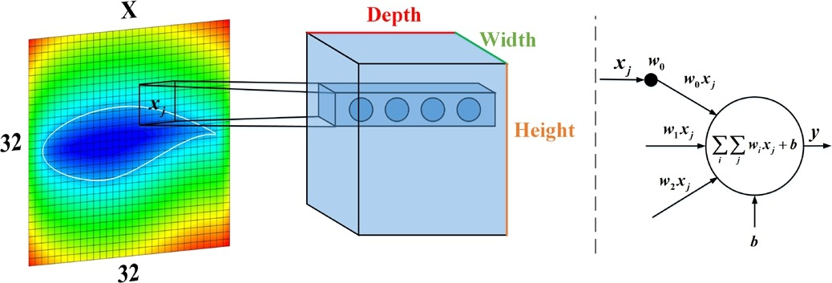
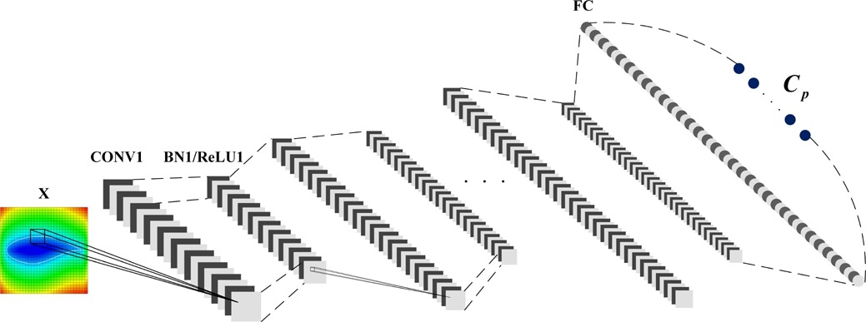
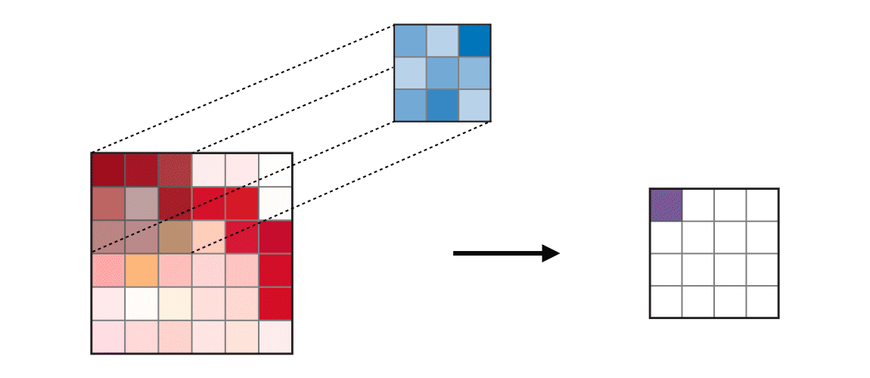
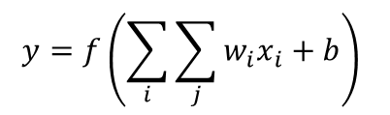
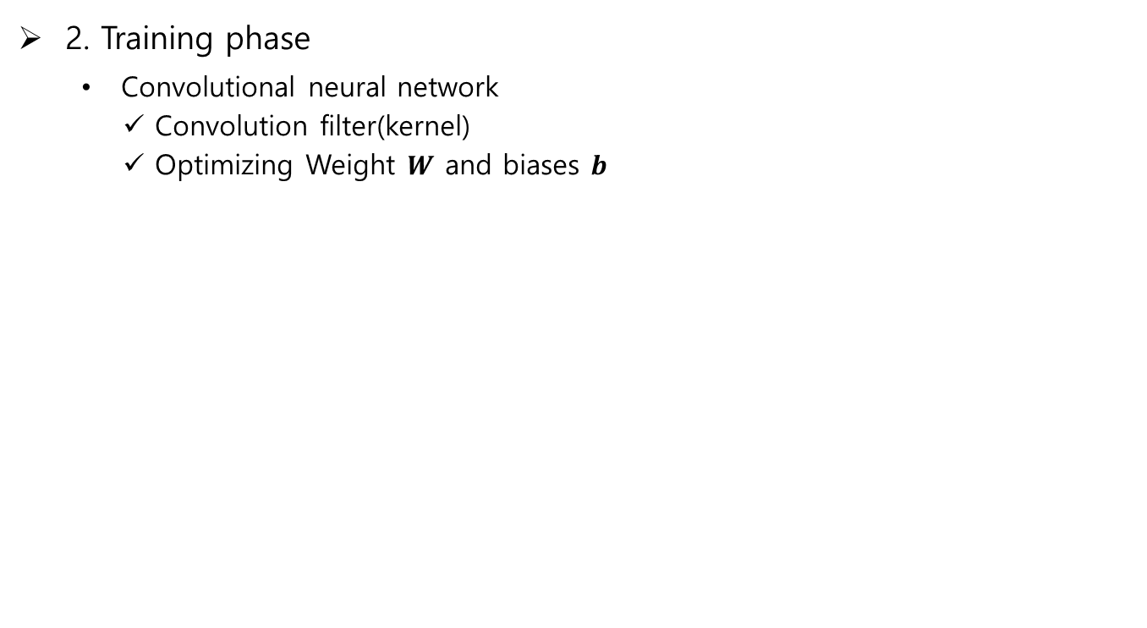
Machine learning method
Entire framework
2. Training phase
Convolutional neural network
Convolution filter(kernel)
Optimizing Weight $W$ and biases $b$
< Output > Airfoil pressure coefficient
Convolution filter
< Input > Airfoil image
$$y=f\left(\sum_{i}{\sum_{j}{w_{i}x_{i}}+b}\right)$$
Extract local features/patterns
Activation function
weight
bias
Notes:
During the convolution process, each fil-ter will slide across the input’s width and height, giving us the responses at every spatial position.
Through the accumulation of each layer, this network will learn the entire patterns

Slide 7
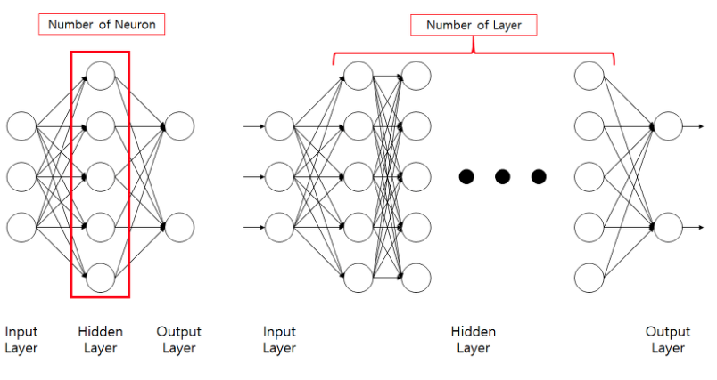
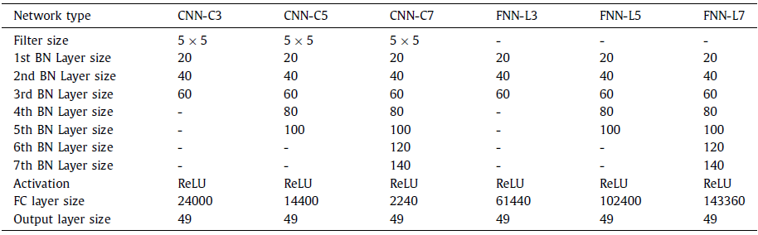
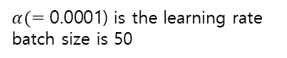
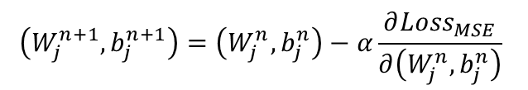
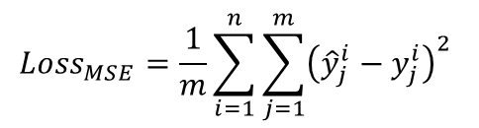
Result and discussion
Parameters setting
Hyperparameter
These networks are investigated by varying the number of convolutional layers
Training under Adam optimizer and MSE loss function
Network hyperparameter
Convolution neural network
Fully connected neural network
$${Loss}_{MSE}=\frac{1}{m}\sum_{i=1}^{n}{\sum_{j=1}^{m}{{\left({\hat{y}}_{j}^{i}−y_{j}^{i}\right)}^{2}}}$$
$$\left(W_{j}^{n+1},b_{j}^{n+1}\right)=\left(W_{j}^{n},b_{j}^{n}\right)−α\frac{∂{Loss}_{MSE}}{∂\left(W_{j}^{n},b_{j}^{n}\right)}$$
Network parameter optimization
$α(=\text{0.0001)}$ is the learning rate
batch size is 50
Notes:
The number of layers, number of nodes in each layer, kernel size, and choice of activation functions are often referred to as hyperparameters which are usually selected before training.
Furthermore, all the hyperparameters, such as learning rate, batch size, and any parameters that need to be decided before training, will be consistent between CNN and FNN.

Slide 8
Result and discussion
Pressure coefficient prediction based on CNN
Convergence history of the designed CNN architectures of upper and lower surface in training and validation datasets.
CNN-C5 architecture is considered as the base model for further study because of its steady performances
CNN-C5
Upper surface
Lower surface
CNN-C5
Convergence history of the designed CNN architectures
Test accuracy for upper and lower surface
Predicted Cp of random sampled airfoils
Notes:
At the leading edge, CNN performs worse because of the variation in the leading edge along Ycoordinate. Around the shock wave zone, CNN performs great, which proves that our model can capture the nonlinear features that play an important role in fluid mechanics.
As can be seen, these four pressure forms show different features from the original airfoil RAE2822. Either a double shock structure or strong shock waves are detected for these airfoils.
At the leading edge, CNN performs worse because of the variation in the leading edge along Y coordinate.
Around the shock wave zone, CNN performs great, which proves that our model can capture the nonlinear features that play an important role in fluid mechanics.

Slide 9
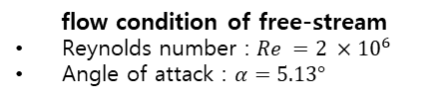
Result and discussion
Pressure coefficient prediction based on CNN
Retrain and test the CNN-C5 model on new base airfoil model : S809
New dataset is employed to prove the robustness of CNN-C5 model
flow condition of free-stream
Reynolds number : $Re =2 ×{10}^{6}$
Angle of attack : $α=5.13°$
S809 airfoil
Upper surface
Lower surface
Predicted pressure coefficient of S809 airfoil
Convergence history of the CNN-C5
Notes:
S809, whose aerodynamic characteristics are representative of wind-turbine airfoil

Slide 10
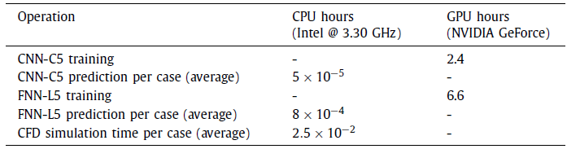
Result and discussion
Performance comparison between CNN and FNN
The performance comparison between CNN and FNN
Training and test loss convergence history
Training time
Convergence history of CNNs and FNNs in training and validation datasets of upper surface
Comparison of time requirements.
Notes:
S809, whose aerodynamic characteristics are representative of wind-turbine airfoil
At last, the summary of the computational time of the model training and prediction are shown in Table3, along with the time required for CFD simulations. CNN-C5 training saves more than half of the time compared to FNN-L5. Because the number of pa-rameters of CNN is remarkably reduced by the convolutional func-tions, where FNN-L5 must handle 102400 parameters when the information flows through the last layer, only 14400 parameters are considered by CNN-C5. CNN keeps accuracy and efficiency at the same time.

Slide 11
Result and discussion
Performance comparison between CNN and FNN
The performance comparison between CNN and FNN
It is apparent that all three FNNs fail to capture the aerodynamic features
discrepancy
Predicted pressure coefficient predicted by CNN and FNN
Notes:
It is apparent that all three FNNs fail to capture the aerodynamic features, especially for FNN-L7, its model collapses cause the pressure shown in four variants are precisely the same.

Slide 12
Conclusion
Conclusion
Methodology to predict the pressure distribution (Cp) over an airfoil using deep learning (CNN) is proposed.
To effective deal with data, SDF method is introduced to convert airfoils into image data
Comparing between conventional FNN and CNN, it is observed that CNN has superior performance dealing with image data.
Further analysis of CNN, the test results has good agreement with original data.
Notes:
S809, whose aerodynamic characteristics are representative of wind-turbine airfoil

